Slide 1


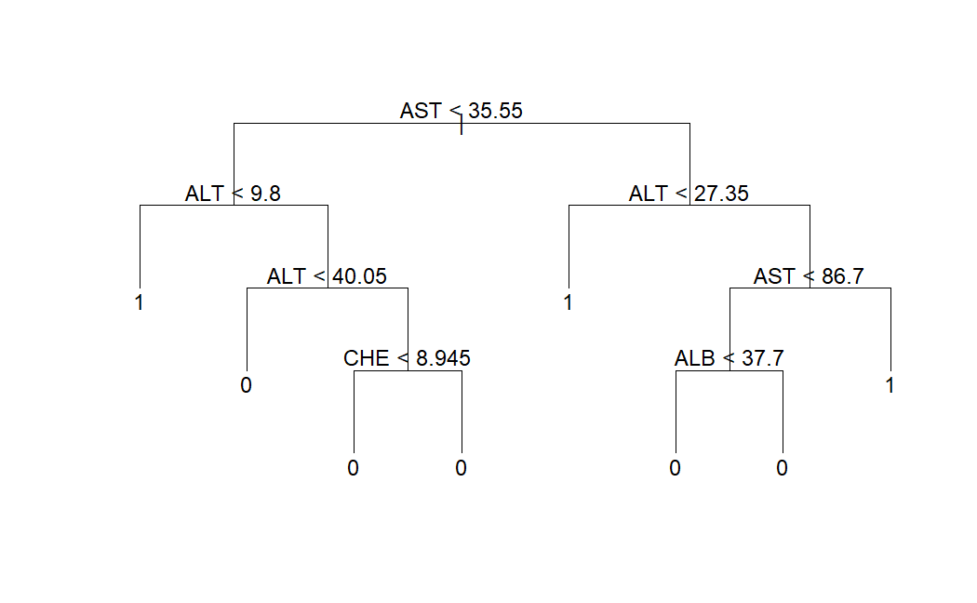
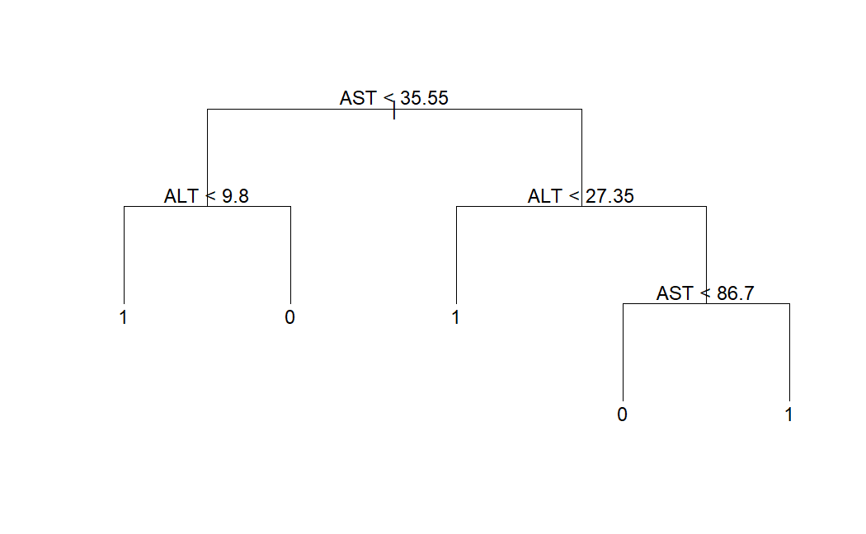
Machine Learning Methods to Identify Hepatitis C Risk Factors in
Blood Donors Based on Biochemical Indicators
Yu Chieh Cheng, Chien Hsiao, He Jin Chu - American University STAT 627 Final Project
Introduction / Context:​
Early detection of Hepatitis C in blood donors through data analysis is crucial for identifying health risks. ​
Accurate predictions enhance blood donation safety and reduce infection risks. ​
Guaranteeing risk-free blood tested in secure conditions is essential for public health.
 | Methods | Accuracy Rate | Parameters
Status | Logistic Regression | 93.22% | 8
 | LDA | 95.42% | 13
 | Classification Tree | 97.03% | 2
 | Random Forest | 97.88% | 3
 | Support Vector Machine | 98.98% | 13
Results:
The SVM method is the best fit for HCV data.
SVM accuracy rate is the highest among all of the methods.
Finding more data to enhance the reliability of the results.
Assumptions/Limitations/Challenges:
Case-wise deletion for handling missing values may lead to the loss of important information and potentially introduce non-random bias.
The assumption is that the dataset has no systematic errors or biases, ensuring the biochemical data reliably represents the donors' health.
Approach:
Explored five different methods for classification, utilizing cross-validation techniques to identify the most suitable model.
Feature selection was employed using statistical correlation to predict biochemical indicators, ensuring a targeted analytical approach.
The predictive performance of the model was assessed using a series of metrics, including accuracy.
Ethical Implications:
Case-wise deletion removes any record with missing data, which can introduce bias and affect result reliability.
# Before Prune
# After Prune
Reference:
Lichtinghagen, R., Klawonn, F., & Hoffmann, G. (2020). HCV data [Data set]. UCI Machine Learning Repository. https://doi.org/10.24432/C5D612
Data:
Source: UC Irvine Machine Learning Repository
Size/Scale: 615*14
Stakeholders:
Blood Donors
Donation Centers
Public Health Authorities

